Slide 1
Secure Data Hiding in Images using Steganography
CAPSTONE PROJECT
Presented By: Ahart Deogade
College Name: Priyadarshini College of Engineering, Nagpur
Department: Artificial Intelligence and Data Science

Slide 2
OUTLINE
Problem Statement
Technology used
Wow factor
End users
Result
Conclusion
Git-hub Link
Future scope

Slide 3
Problem Statement
With increasing concerns about data privacy, text encryption methods are essential for securing sensitive information.
This project implements a simple yet effective method of encrypting text within an image, ensuring that only authorized users can retrieve the message using a passcode.

Slide 4
Technology used
Python
OpenCV (cv2)
OS module
String Manipulation

Slide 5
Wow factors
Unique image-based encryption technique
No need for external databases or complex cryptographic algorithms
Secure decryption using a passcode

Slide 6
End users
Cybersecurity enthusiasts
Students learning cryptography
Individuals needing secure communication

Slide 7
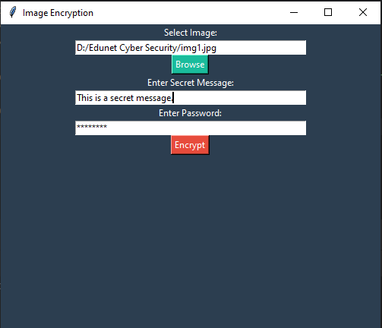
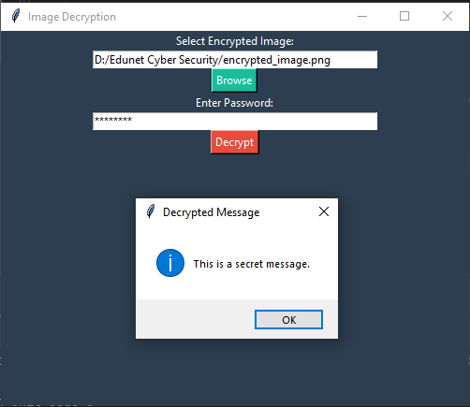

Results

Slide 8
Conclusion
This project demonstrates an innovative approach to text encryption using images.
By embedding characters into pixel values, we can securely store messages without traditional encryption methods.
The passcode mechanism ensures only authorized access to the hidden information.

Slide 9
GitHub Link
ahartdeogade/Secure-Data-Hiding-in-Images-using-Steganography

Slide 10
Future scope(optional)
Implementing advanced cryptographic algorithms for added security
Enhancing support for larger messages
Developing a user-friendly GUI for ease of use

Slide 11
THANK YOU

